Slide 1
Regression, Prediction and Model Complexity
Jacob LaRiviere
Some content taken from Justin Rao and Brian Quistorff

Slide 2
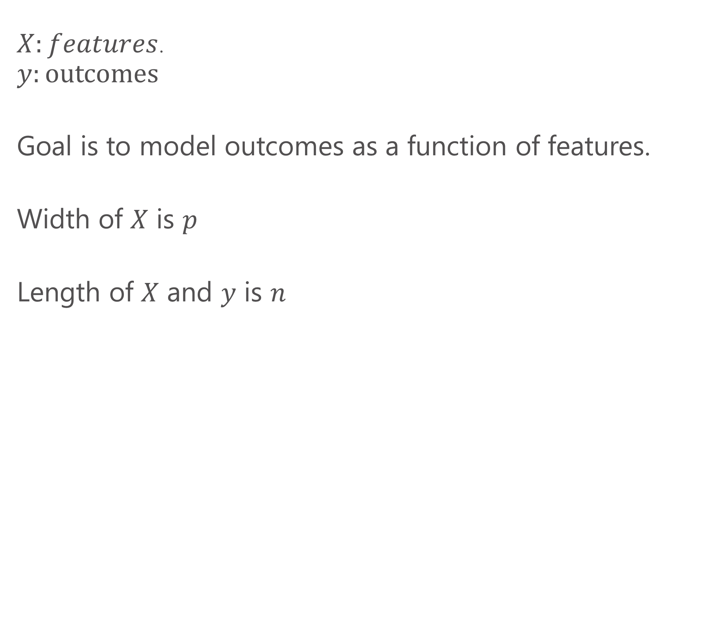
Terminology
$X:features$.
$$y:\text{outcomes}$$
Goal is to model outcomes as a function of features.
Width of $X$ is $p$
Length of $X$ and $y$ is $n$

Slide 3
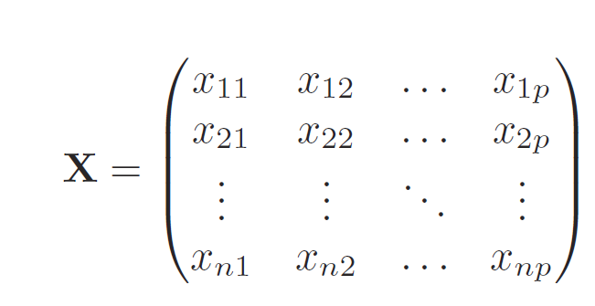
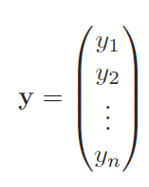
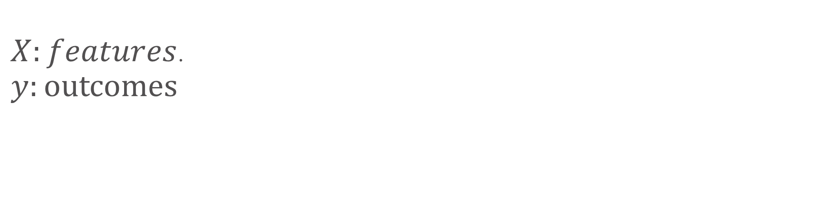
Terminology cont.
$X:features$.
$$y:\text{outcomes}$$
Feature 1
Obs 1
Obs 1

Slide 4
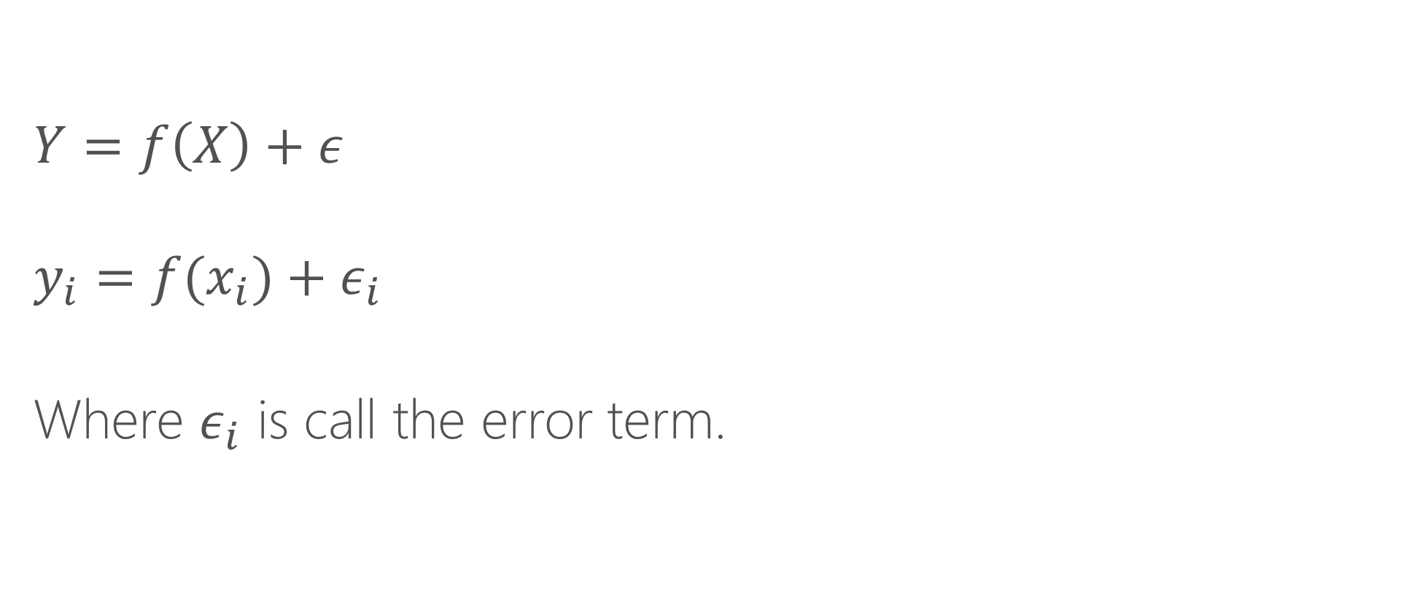
Estimating equations
$$Y=f\left(X\right)+ε$$
$$y_{i}=f(x_{i})+ε_{i}$$
Where $ε_{i}$ is call the error term.

Slide 5
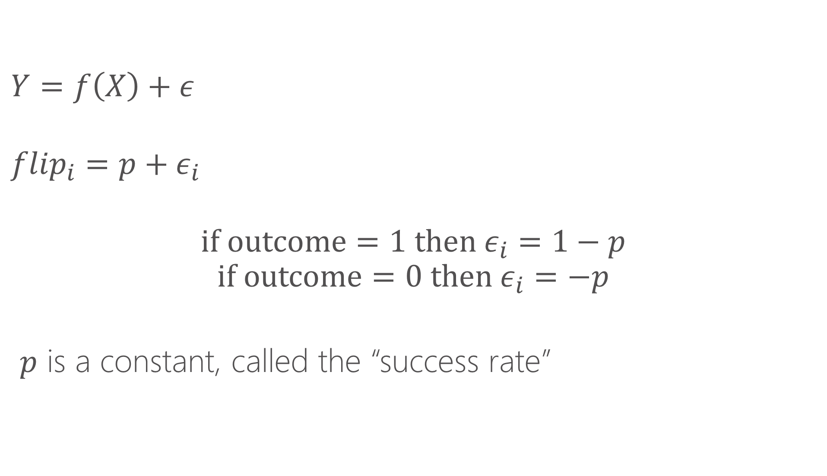
Example: coin flipping
$$Y=f\left(X\right)+ε$$
$${flip}_{i}=p+ε_{i}$$
$$if outcome=1 then ε_{i}=1−p$$
$$if outcome=0 then ε_{i}=−p$$
$p$ is a constant, called the “success rate”

Slide 6
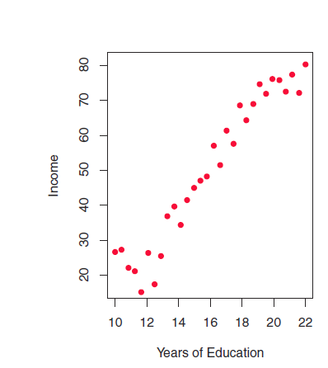
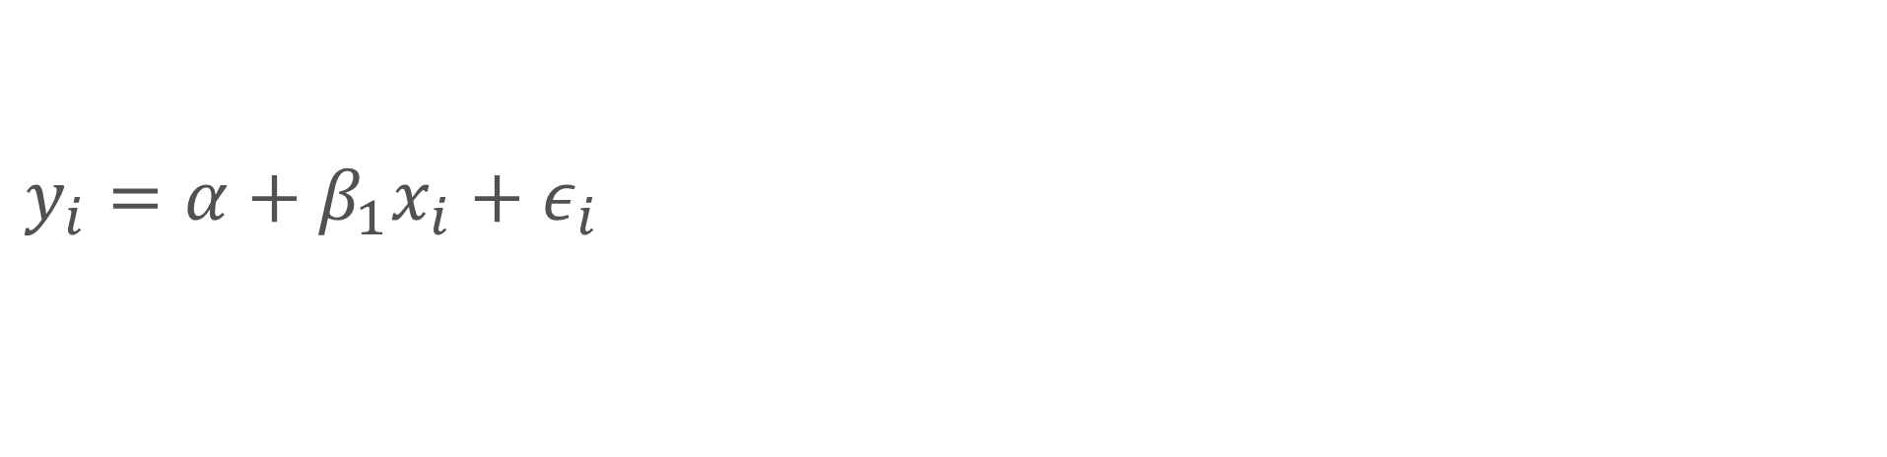
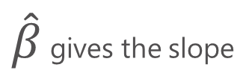
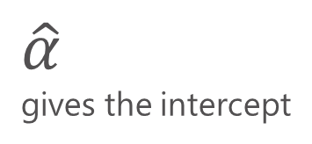
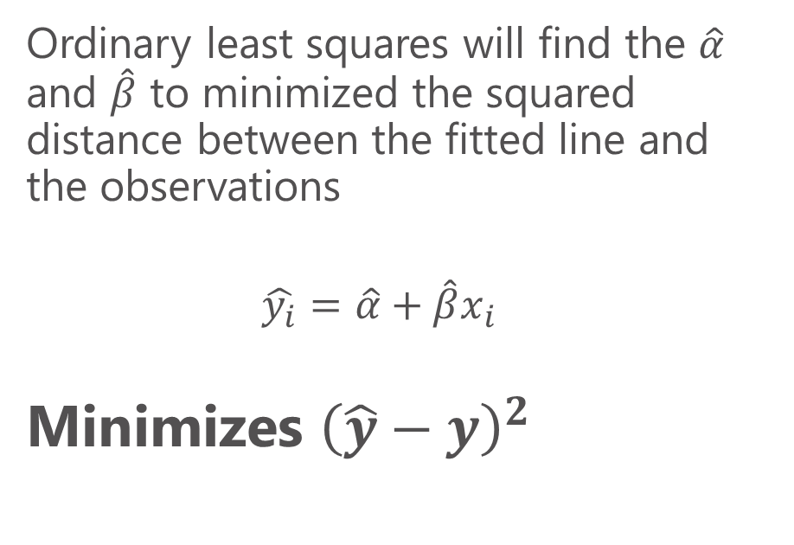
Linear regression
$\hat{β}$ gives the slope
$$y_{i}=α+β_{1}x_{i}{+ ε}_{i}$$
Ordinary least squares will find the $\hat{α}$ and $\hat{β}$ to minimized the squared distance between the fitted line and the observations
$$\hat{y_{i}}=\hat{α}+{\hat{β}x}_{i}$$
Minimizes ${\left(\hat{y}−y\right)}^{2}$
$\hat{α}$
gives the intercept

Slide 7
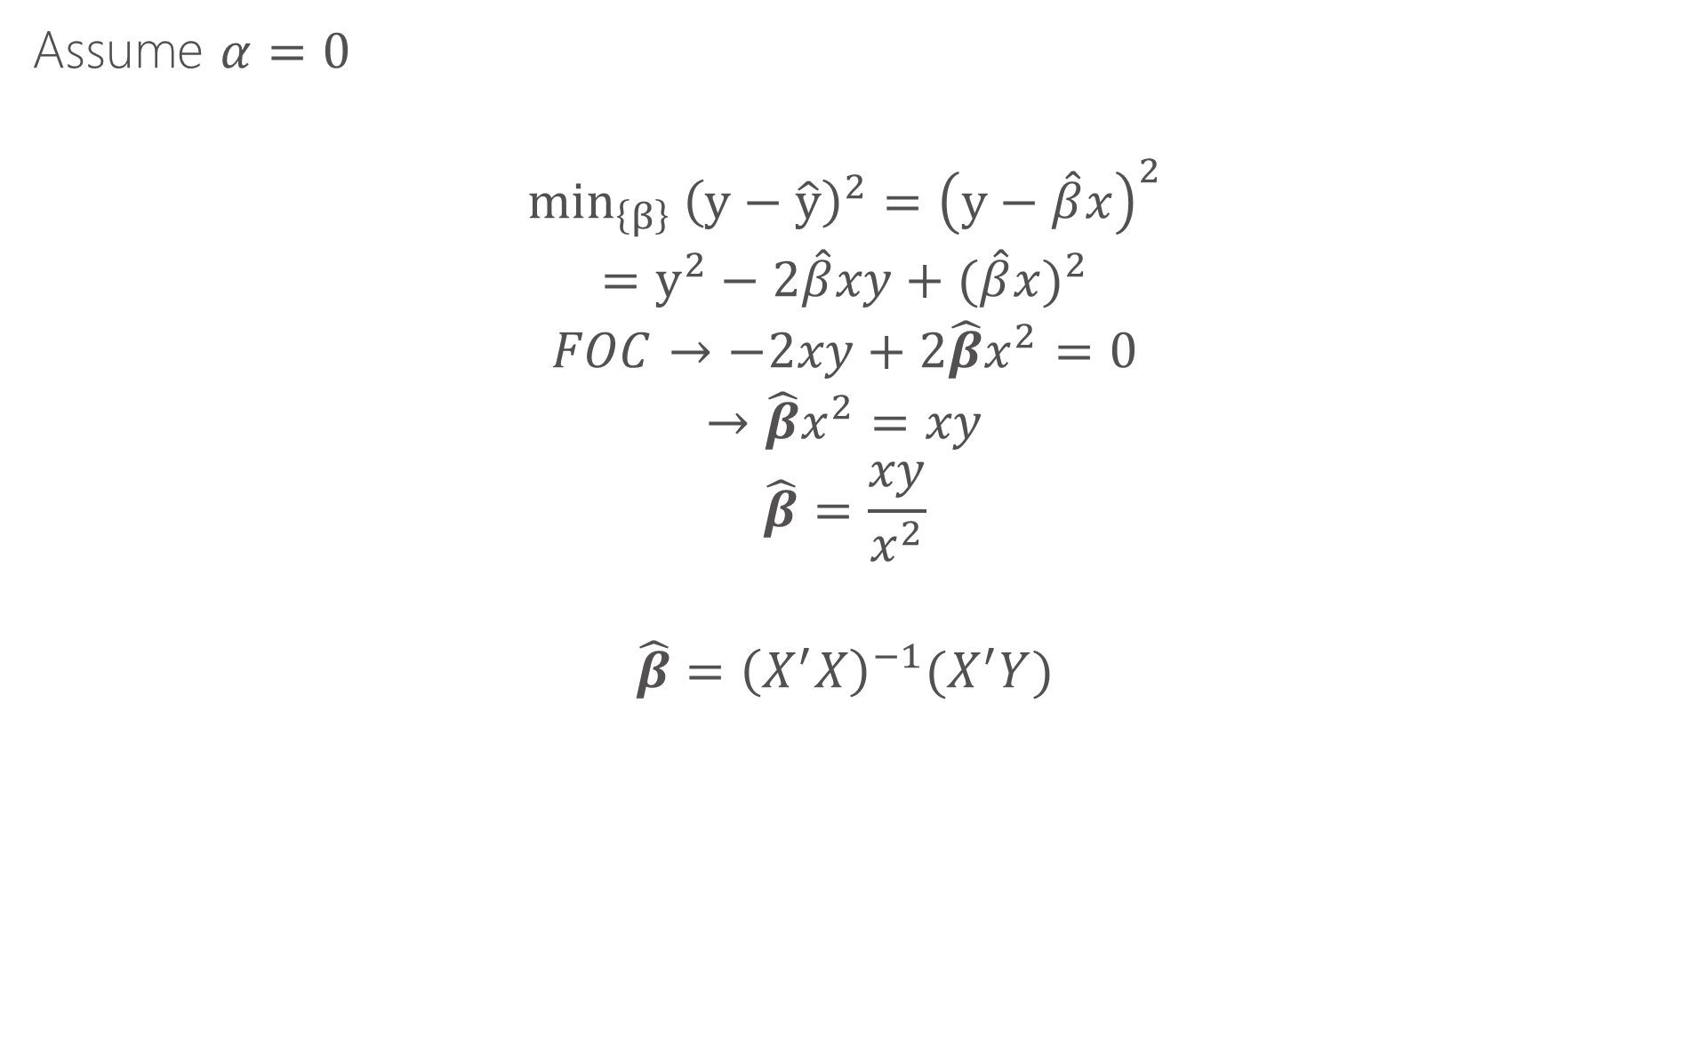
How does this work intuitively?
Assume $α=0$
$${min_{\left\{β\right\}} \left(y−\hat{y}\right)}^{2}={\left(y−\hat{β}x\right)}^{2}$$
$$=y^{2}−2\hat{β}xy+{(\hat{β}x)}^{2}$$
$$FOC→−2xy+{2\hat{β}x}^{2}=0$$
$$→{\hat{β}x}^{2}=xy$$
$$\hat{β}=\frac{xy}{x^{2}}$$
$$\hat{β}={\left(X^{′}X\right)}^{−1}(X^{′}Y)$$

Slide 8
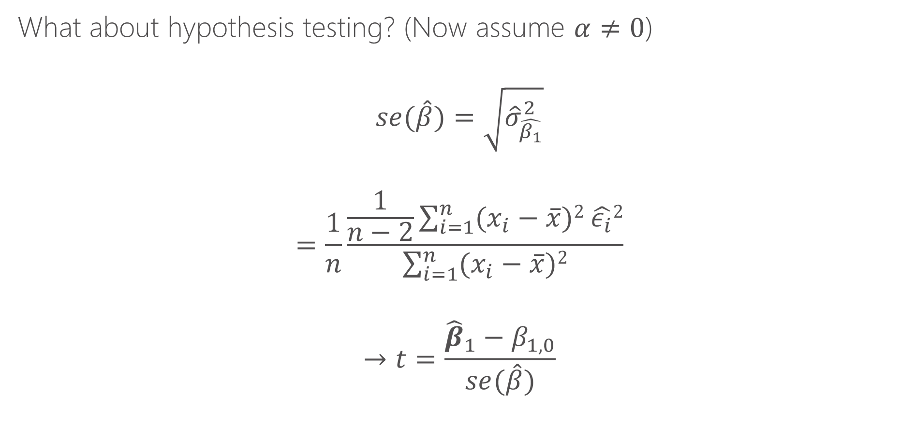
How does this work for inference?
What about hypothesis testing? (Now assume $α≠0$)
$$se(\hat{β})=\sqrt{{\hat{σ}}_{\hat{β_{1}}}^{2}}$$
$$=\frac{1}{n}\frac{\frac{1}{n−2}\sum_{i=1}^{n}{(x_{i}−\overline{x}})2 \hat{ε_{i}}2}{\sum_{i=1}^{n}{(x_{i}−\overline{x}})2}$$
$$→t=\frac{{\hat{β}}_{1}−β_{1,0}}{se(\hat{β})}$$
Both of these are themselves sample statistics from from data y and X. As a result, they both have their own distributions (e.g., normal and Chi Squared). The results ration has the Student t distribution which is used for hypothesis testing for a given sample.

Slide 9
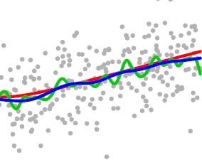
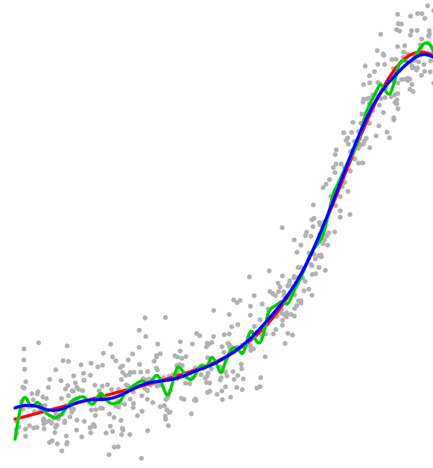
Height as function of age
Growth is most rapid in ages 12-16
AGE

Slide 10
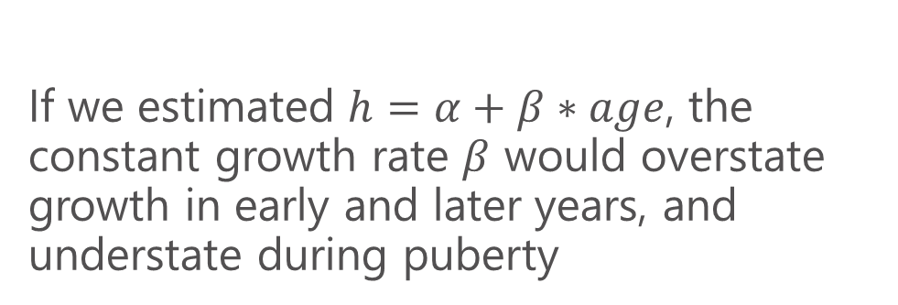
Height as function of age
If we estimated $h=α+β∗age$, the constant growth rate $β$ would overstate growth in early and later years, and understate during puberty
AGE

Slide 11
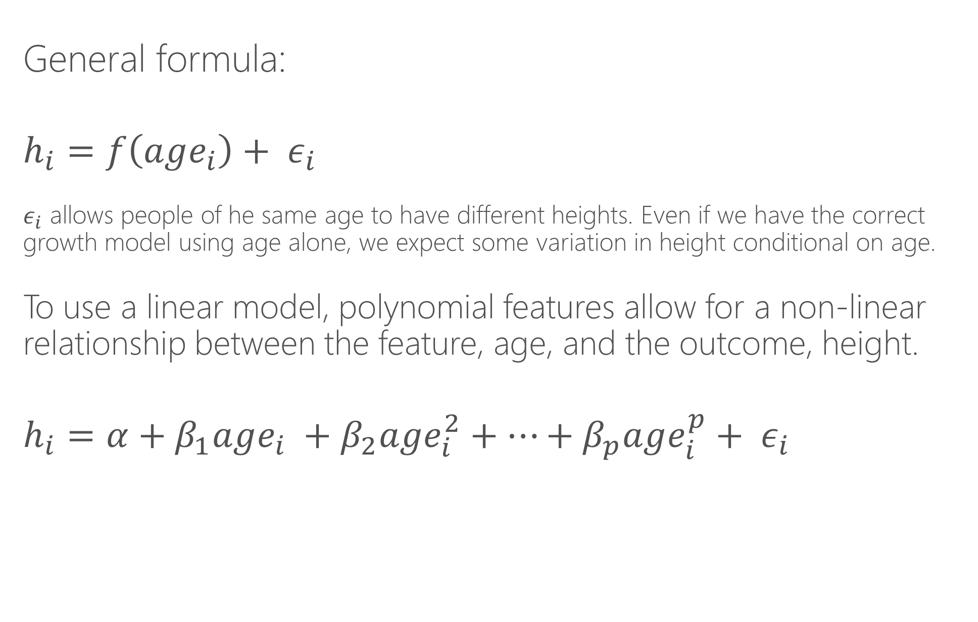
How would we estimate this relationship?
General formula:
$$h_{i}=f\left(age_{i}\right)+ ε_{i}$$
$ε_{i}$ allows people of he same age to have different heights. Even if we have the correct growth model using age alone, we expect some variation in height conditional on age.
To use a linear model, polynomial features allow for a non-linear relationship between the feature, age, and the outcome, height.
$$h_{i}=α+β_{1}age_{i} +β_{2}age_{i}^{2}+…+β_{p}age_{i}^{p}+ ε_{i}$$

Slide 12
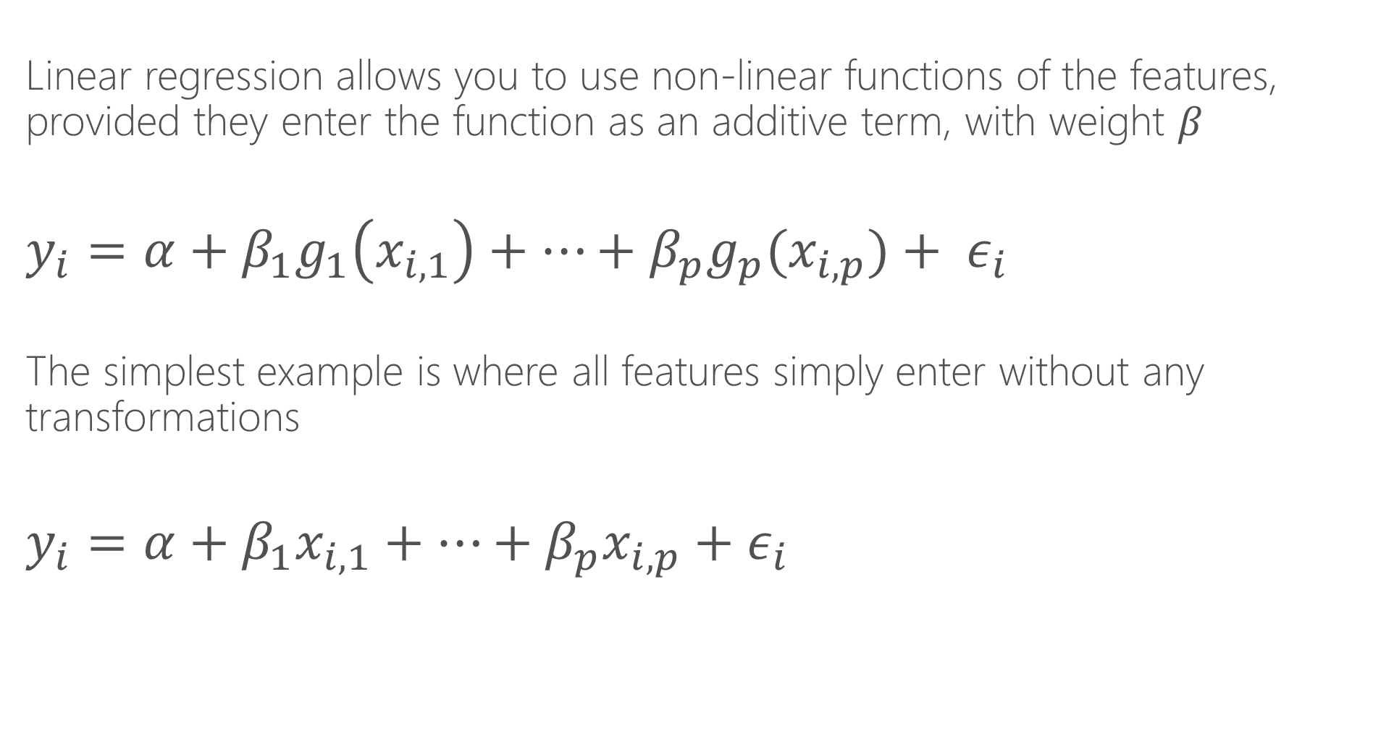
Linear regression
Linear regression allows you to use non-linear functions of the features, provided they enter the function as an additive term, with weight $β$
$$y_{i}=α+β_{1}g_{1}\left(x_{i,1}\right)+…+β_{p}g_{p}(x_{i,p})+ ε_{i}$$
The simplest example is where all features simply enter without any transformations
$$y_{i}=α+β_{1}x_{i,1}+…+β_{p}x_{i,p}{+ ε}_{i}$$

Slide 13
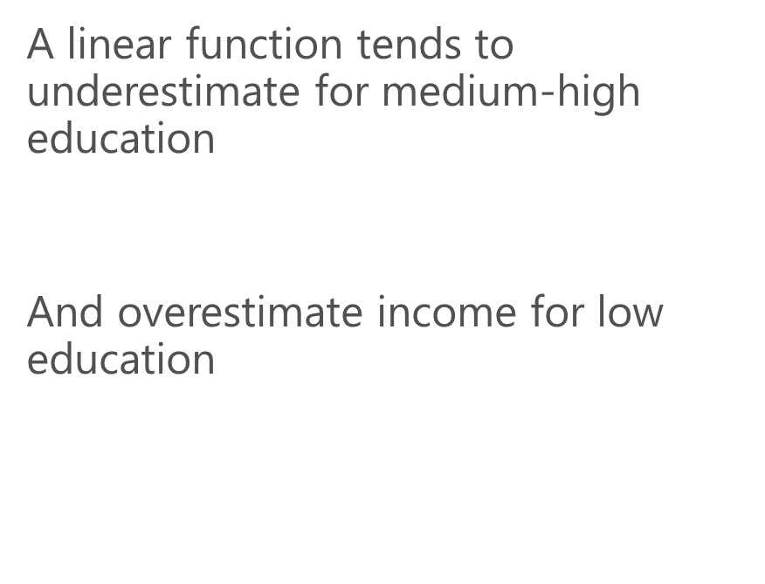
Linear regression
$$y_{i}=α+β_{1}x_{i}{+ ε}_{i}$$
A linear function tends to underestimate for medium-high education
And overestimate income for low education

Slide 14
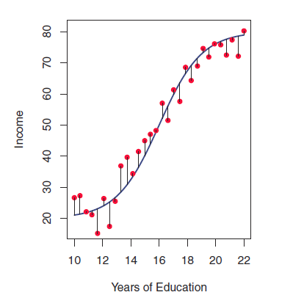
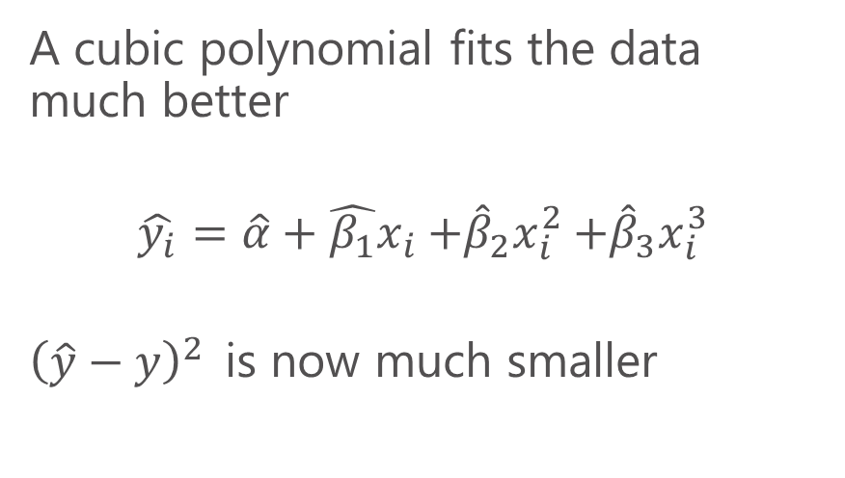
Linear regression
A cubic polynomial fits the data much better
$$\hat{y_{i}}=\hat{α}+{\hat{β_{1}}x}_{i}{+{\hat{β}}_{2}x}_{i}^{2}+{{\hat{β}}_{3}x}_{i}^{3}$$
${\left(\hat{y}−y\right)}^{2}$is now much smaller

Slide 15
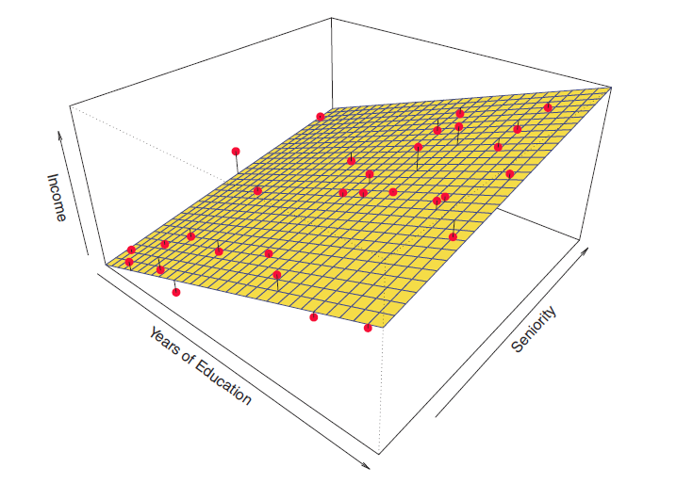
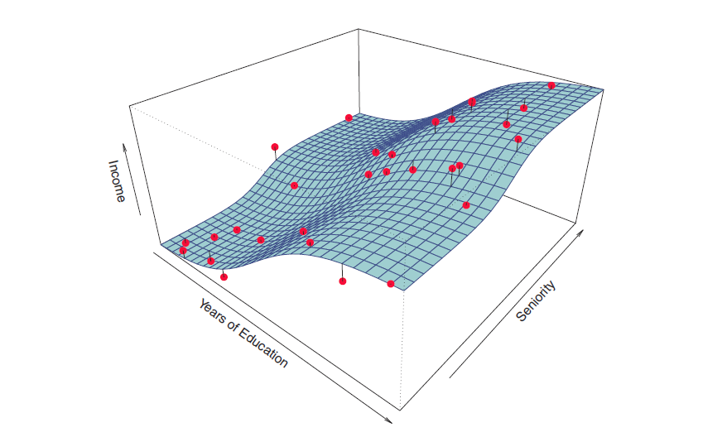
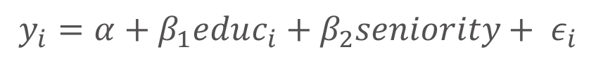
Visualizing in two dimensions
Higher order polynomial in educ and seniority could approximate this function
$$y_{i}=α+β_{1}educ_{i}{+ β_{2}seniority+ ε}_{i}$$

Slide 16
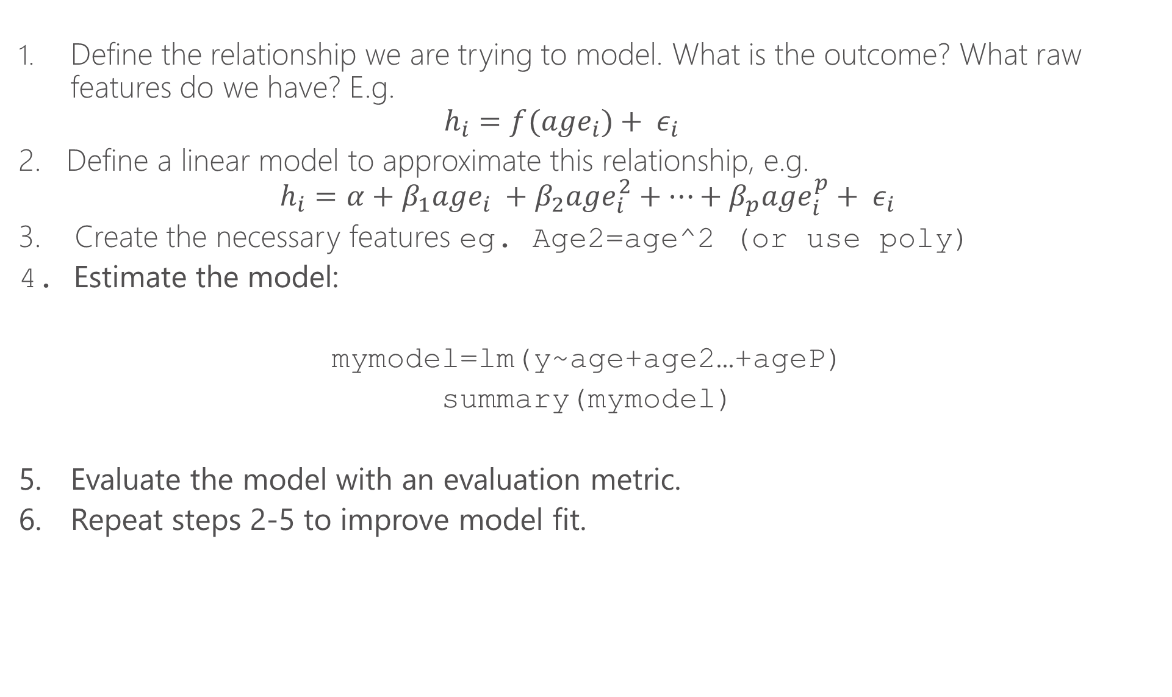
Steps for linear regression
Define the relationship we are trying to model. What is the outcome? What raw features do we have? E.g.
$$h_{i}=f(age_{i})+ ε_{i}$$
2. Define a linear model to approximate this relationship, e.g.
$$h_{i}=α+β_{1}age_{i} +β_{2}age_{i}^{2}+…+β_{p}age_{i}^{p}+ ε_{i}$$
3. Create the necessary features eg. Age2=age^2 (or use poly)
4. Estimate the model:
mymodel=lm(y~age+age2…+ageP)
summary(mymodel)
5. Evaluate the model with an evaluation metric.
6. Repeat steps 2-5 to improve model fit.

Slide 17
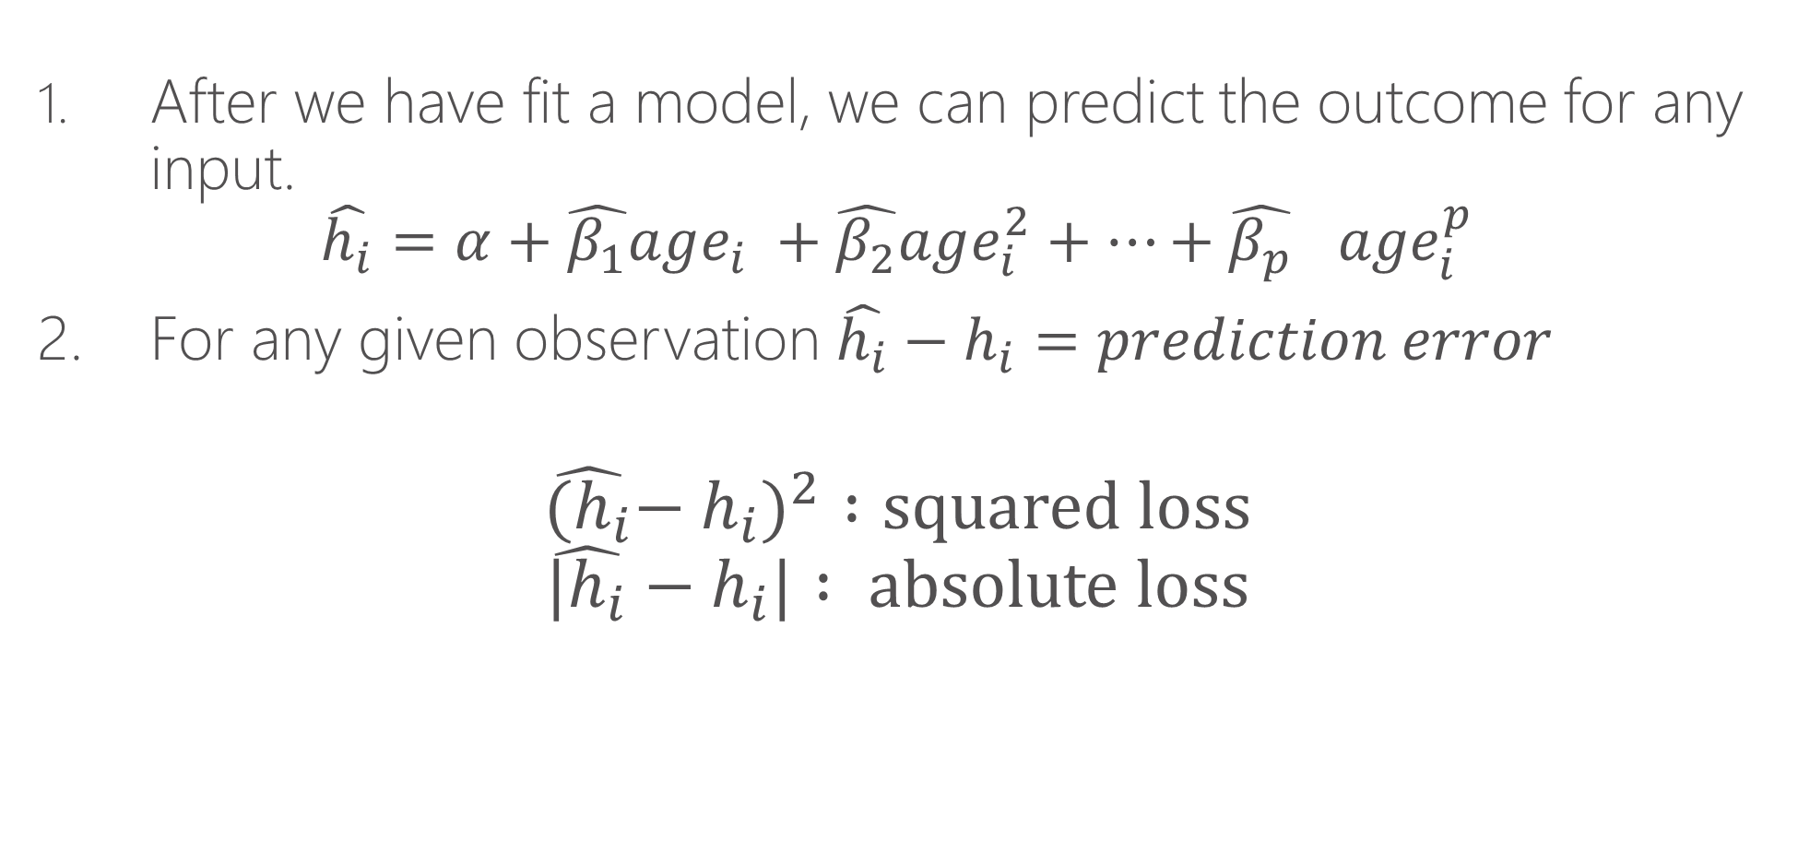
Model prediction
After we have fit a model, we can predict the outcome for any input.
$$\hat{h_{i}}=α+\hat{β_{1}}age_{i} +\hat{β_{2}}age_{i}^{2}+…+{\hat{β_{p}}}_{}age_{i}^{p}$$
2. For any given observation $\hat{h_{i}}−h_{i}=prediction error$
$${\hat{{(h}_{i}}−h_{i})}^{2} :squared loss$$
$$\hat{{|h}_{i}}−h_{i}| : absolute loss$$

Slide 18
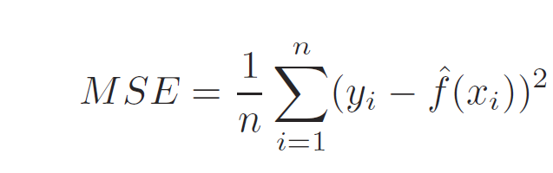
Model Fit
Fit refers to how well our model, an approximation of reality, matches what we actually observe in the data
Mean squared error is the average of squared loss for each data point (row) we evaluate

Slide 19
Training vs. Test
We typically want to “train” the model on the data “we have” and test the model on “new data”
This is a realistic test of how well the model predicts outcomes.
In practice, we will subset our data:
X%: Training
1-X%: Test
80% is commonly used for training.

Slide 20
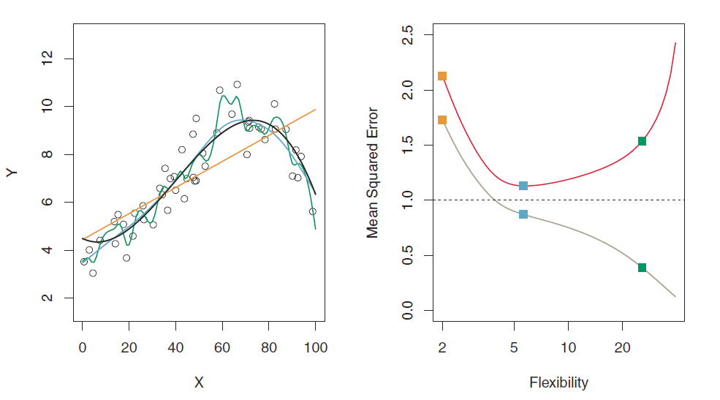
Why do we need training vs. test?
MSE: test set
MSE: training set

Slide 21
Why do we need training vs. test?
The green curve “overfits” the data. It fits the noise.
Using a “out of sample” test set guards against “overfitting”
The blue curve gets closest to the black (truth) curve

Slide 22
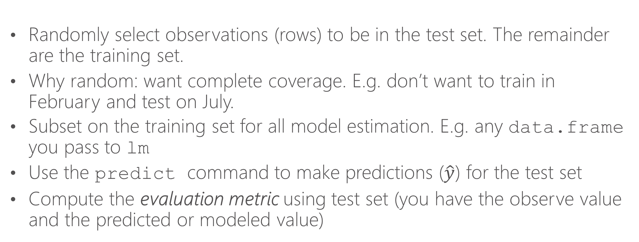
Training vs. test in practice
Randomly select observations (rows) to be in the test set. The remainder are the training set.
Why random: want complete coverage. E.g. don’t want to train in February and test on July.
Subset on the training set for all model estimation. E.g. any data.frame you pass to lm
Use the predict command to make predictions ($\hat{y}$) for the test set
Compute the evaluation metric using test set (you have the observe value and the predicted or modeled value)

Slide 23
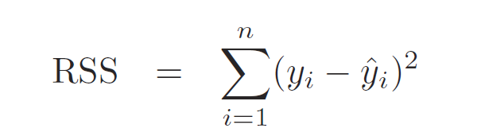
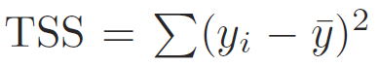
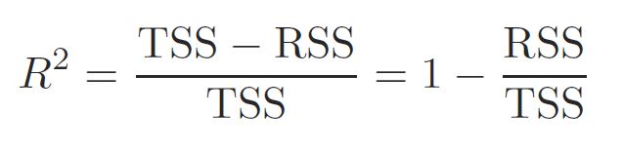
R-squared
Residual sum of squares
Total variation in outcome variable
Fraction of the variation in the outcome variable captured by the model

Slide 24
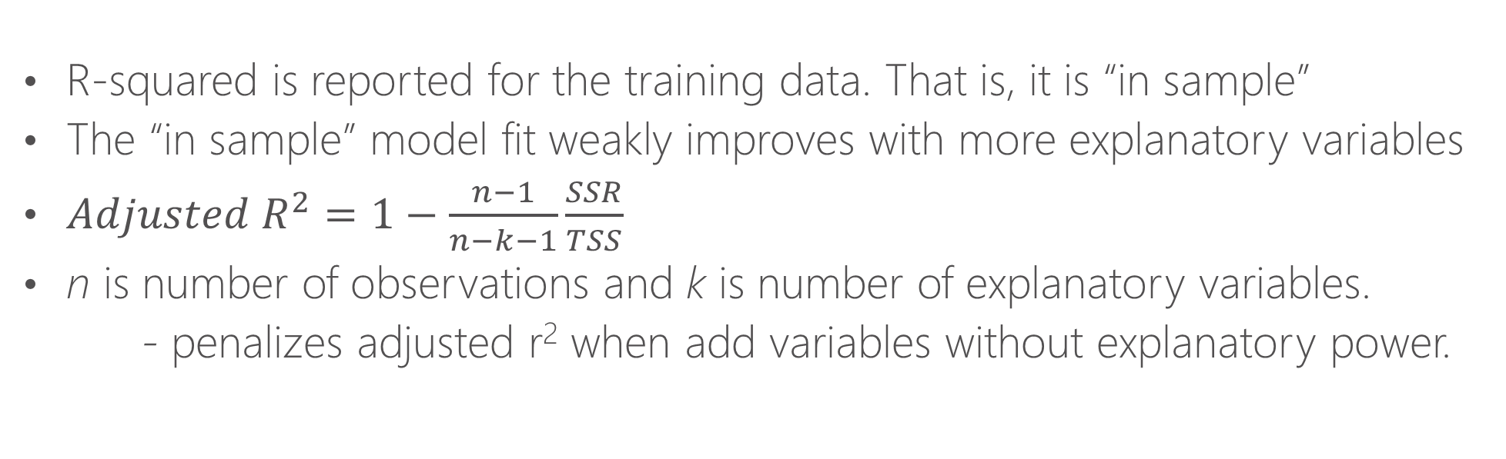
Adjusted R-squared
R-squared is reported for the training data. That is, it is “in sample”
The “in sample” model fit weakly improves with more explanatory variables
$Adjusted R^{2}=1−\frac{n−1}{n−k−1}\frac{SSR}{TSS}$
n is number of observations and k is number of explanatory variables.
- penalizes adjusted r² when add variables without explanatory power.

Slide 25
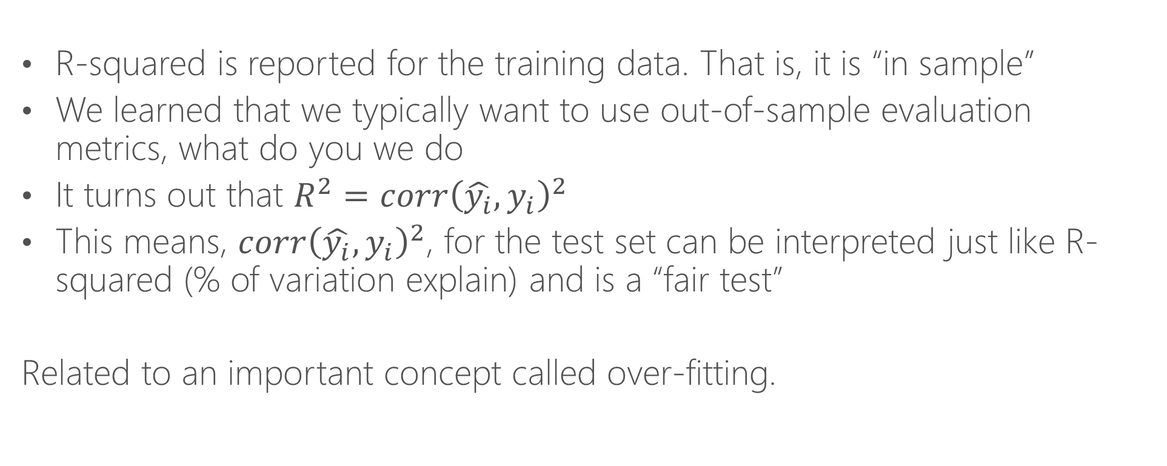
A “Fair” R-squared Measure
R-squared is reported for the training data. That is, it is “in sample”
We learned that we typically want to use out-of-sample evaluation metrics, what do you we do
It turns out that $R^{2}=corr{\left(\hat{y_{i}},y_{i}\right)}^{2}$
This means, $corr{\left(\hat{y_{i}},y_{i}\right)}^{2}$, for the test set can be interpreted just like R-squared (% of variation explain) and is a “fair test”
Related to an important concept called over-fitting.

Slide 26
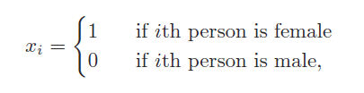
Feature types
Binary features: equal to 1 or 0. For example:
Continuous features: can take an real value
Categorical features: can take one of N values. E.g. Saturday, Sunday, Monday… declaring as.factor then R will treat it as N binary variables for each category (ex. =1 if Saturday, =0 otherwise)

Slide 27
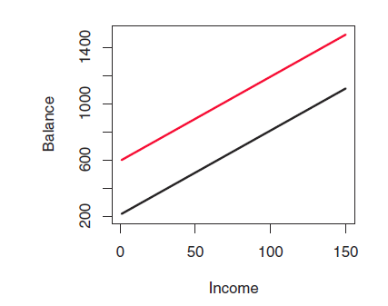
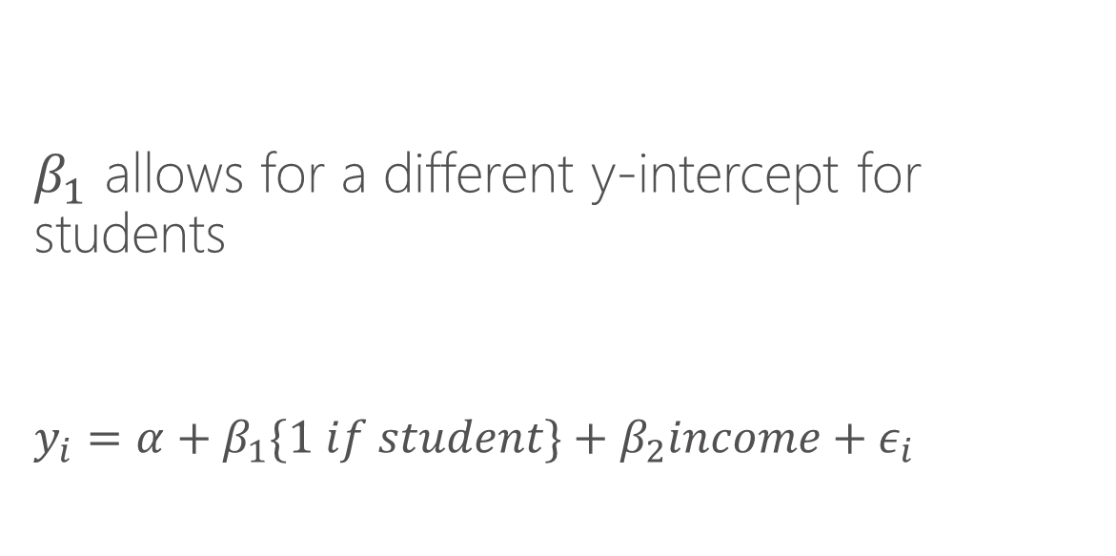
Understand binary features
$β_{1}$ allows for a different y-intercept for students
$$y_{i}=α+β_{1}\{1 if student\}+β_{2}income+ε_{i}$$

Slide 28
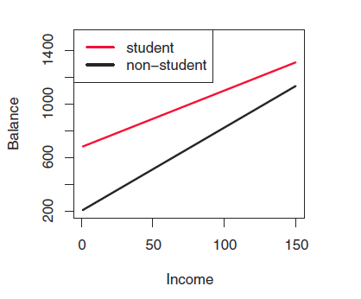
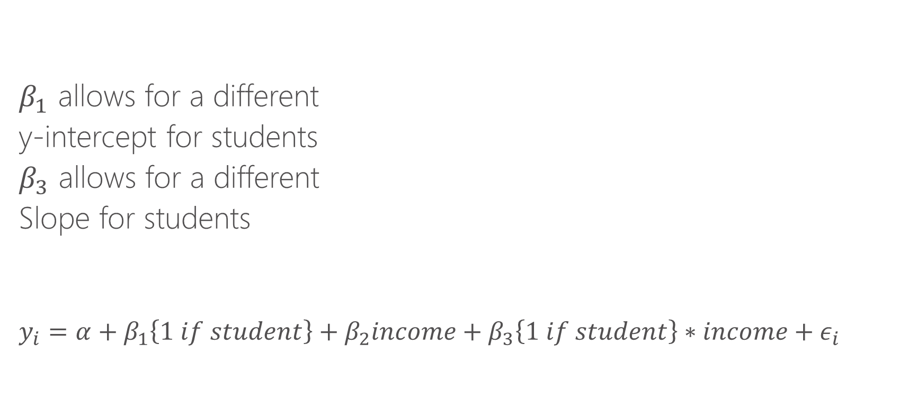
Understand binary features
$β_{1}$ allows for a different
y-intercept for students
$β_{3}$ allows for a different
Slope for students
$$y_{i}=α+β_{1}\left\{1 if student\right\}+β_{2}income+β_{3}\left\{1 if student\right\}∗income+ε_{i}$$

Slide 29
Interaction terms
Interaction term: multiplying two features by each other. When done as such:
{continuous feature}*{binary feature}
it allows for a different slope for the group represented by the binary feature. Note, be sure to include the continuous feature without the interaction as well.
Example, suppose temperature has a different impact on # of bikeshare trips taken on weekdays vs. weekends. We can create a binary variable is_weekend.
If we add is_weekend to the model, we allow for a different baseline ridership on weekends. If we add is_weekend*temp, we allow temperature to have a different effect for weekends.
We can “interact” is_weekend with a polynomial in temp. This effectively gives us a new model for temperature for the weekends vs. weekdays

Slide 30
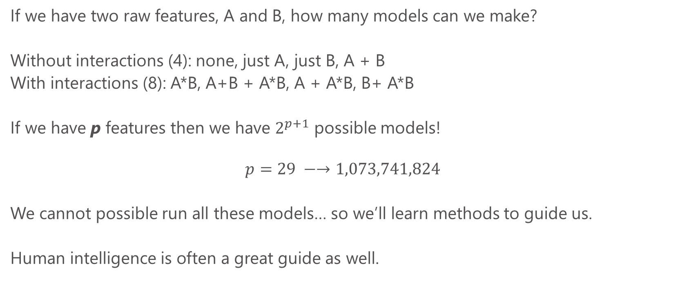
Feature explosion
If we have two raw features, A and B, how many models can we make?
Without interactions (4): none, just A, just B, A + B
With interactions (8): A*B, A+B + A*B, A + A*B, B+ A*B
If we have p features then we have $2^{p+1}$ possible models!
$$p=29 −→1,073,741,824$$
We cannot possible run all these models… so we’ll learn methods to guide us.
Human intelligence is often a great guide as well.

Slide 31
Interpreting regression output
Summary(my_model) gives the coefficient estimates (beta’s), t-statistics, standard errors and p-values.
t-statistics evaluate the hypothesis that the coefficient is equal to zero. Thus t greater than 1.96 in absolute value allows us to reject this hypothesis at the 95% level. P-values simply convert t-stats into the probability we would get something this far from zero due to sampling chance alone.
Note that t-statistics evaluate features “one by one”. Overall model fit is a better guide for explanatory power (e.g. we might be better for leaving insignificant features in sometimes)
t-stats can be a good guide to throw out irrelevant features

Slide 32
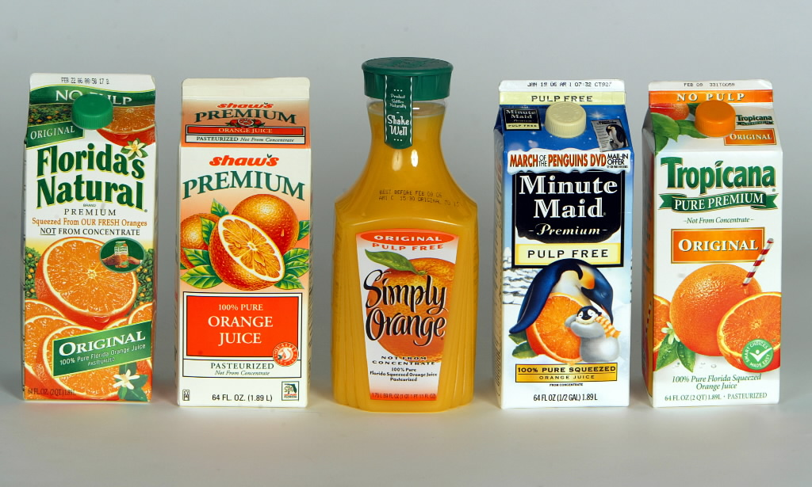
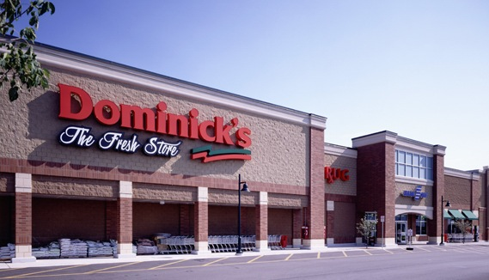
Running Example: Orange Juice
Data: 83 Chicago-area stores
At weekly level:
Sales (“log move”)
Average sales price
Whether advertised (“feat”)
At store level:
Various demographics of the shoppers
Data taken from:
“Determinants of Store-Level Price Elasticity” Stephen J. Hoch, Byung-Do Kim, Alan L. Montgomery and Peter E. Rossi
Journal of Marketing Research Vol. 32, No. 1 (Feb., 1995), pp. 17-29

Slide 33
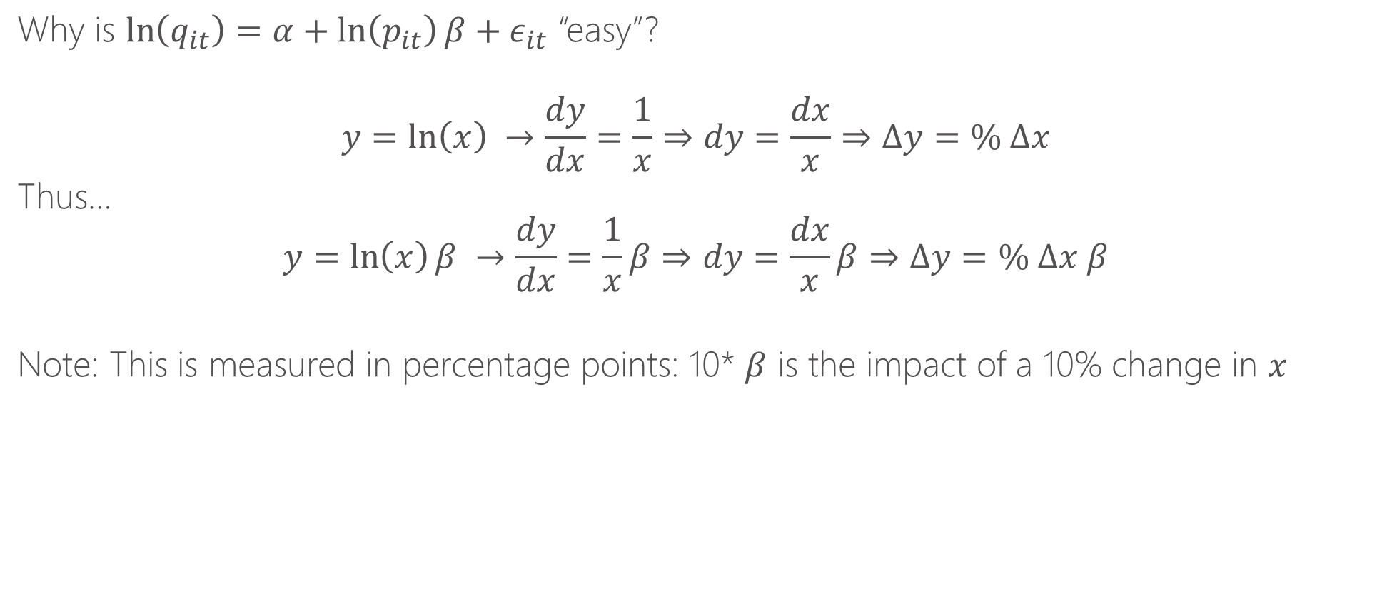
Estimating with natural log is useful for interpretation
Why is $\ln\left(q_{it}\right)=α+\ln\left(p_{it}\right)β+ε_{it}$ “easy”?
$$y=\ln\left(x\right) →\frac{dy}{dx}=\frac{1}{x}⇒dy=\frac{dx}{x}⇒Δy=\% Δx$$
Thus…
$$y=\ln\left(x\right)β →\frac{dy}{dx}=\frac{1}{x}β⇒dy=\frac{dx}{x}β⇒Δy=\% Δx β$$
Note: This is measured in percentage points: 10* $β$ is the impact of a 10% change in $x$

Slide 34
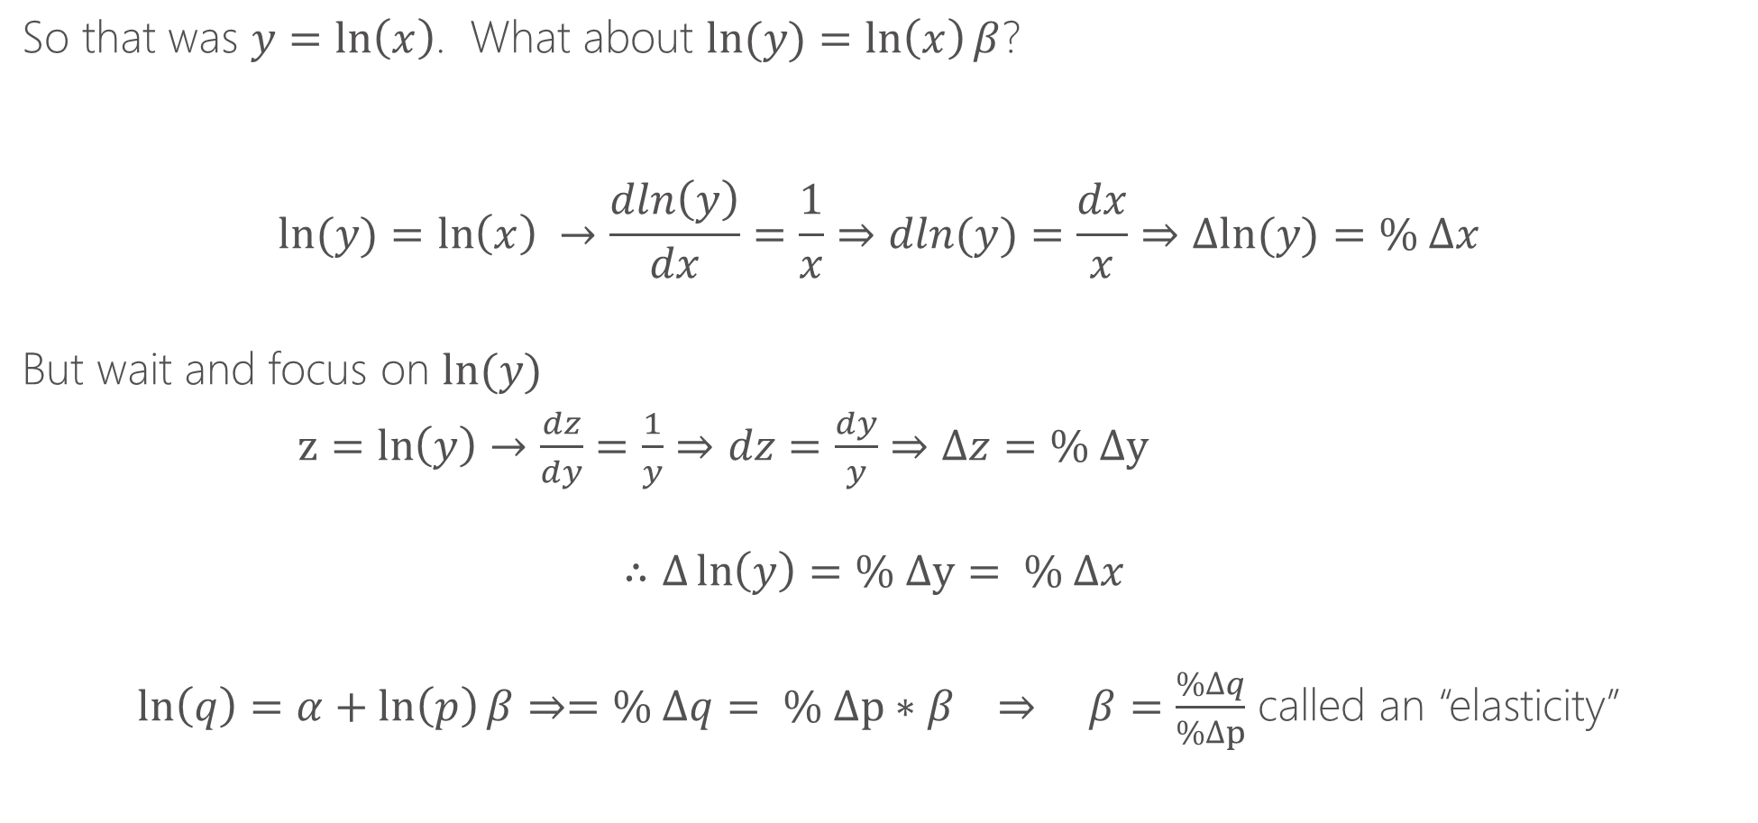
Estimating with natural log is useful for interpretation
So that was $y=\ln\left(x\right)$. What about $ln(y)=\ln\left(x\right)β$?
$$ln⁡(y)=\ln\left(x\right) →\frac{dln\left(y\right)}{dx}=\frac{1}{x}⇒dln(y)=\frac{dx}{x}⇒Δln⁡(y)=\% Δx$$
But wait and focus on $ln⁡(y)$
$z=\ln\left(y\right)→\frac{dz}{dy}=\frac{1}{y}⇒dz=\frac{dy}{y}⇒Δz=\% Δy$
$$∴Δ\ln\left(y\right)=\% Δy= \% Δx$$
$ln\left(q\right)=α+\ln\left(p\right)β⇒=\% Δq= \% Δp∗β ⇒ β=\frac{\%Δq}{\%Δp}$ called an “elasticity”

Slide 35
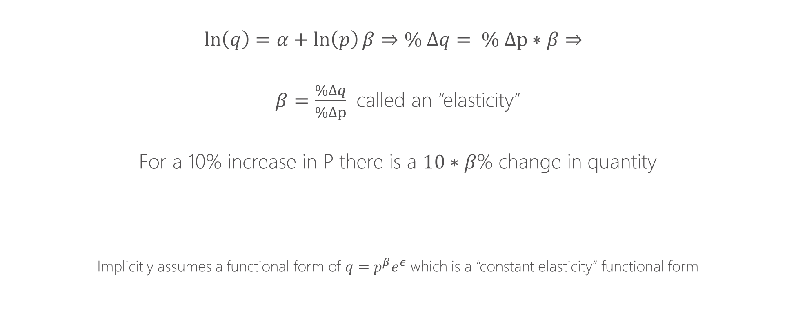
Estimating with natural log is useful for interpretation
$$ln\left(q\right)=α+\ln\left(p\right)β⇒\% Δq= \% Δp∗β⇒$$
$β=\frac{\%Δq}{\%Δp}$ called an “elasticity”
For a 10% increase in P there is a $10∗β$% change in quantity
Implicitly assumes a functional form of $q=p^{β}e^{ε}$ which is a “constant elasticity” functional form

Slide 36
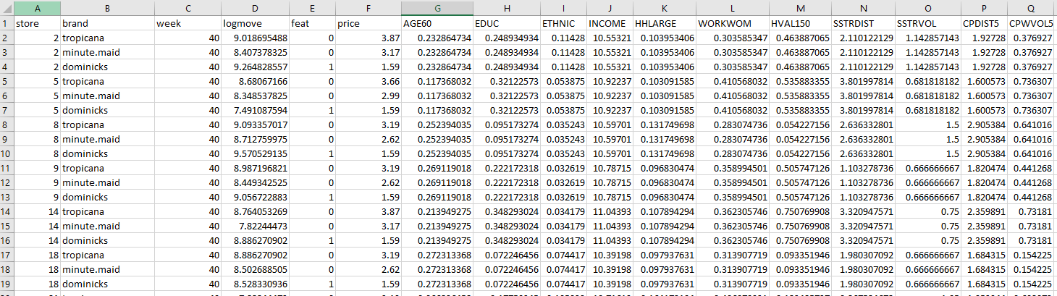
Data
Log of quantity sold each week
Price is not logged
Demographics of shoppers by store
We’ll study 3 brands, “dominicks” is the store’s brand
1 if advertised that week by that store, 0 if not

Slide 37
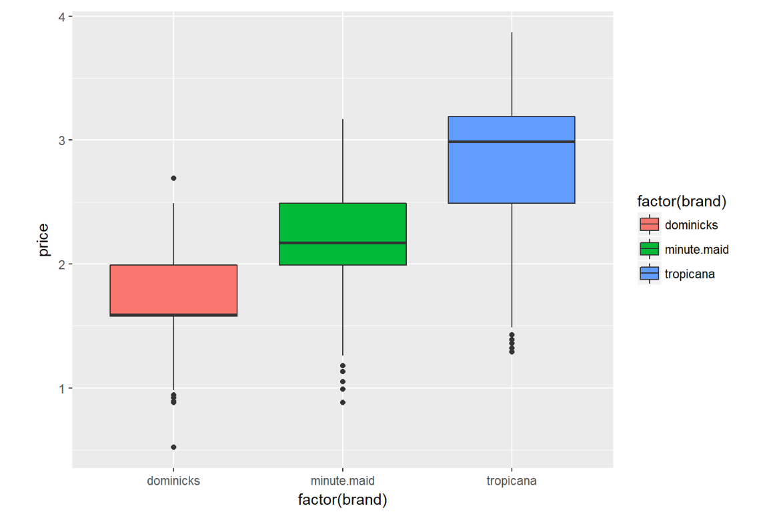

Slide 38
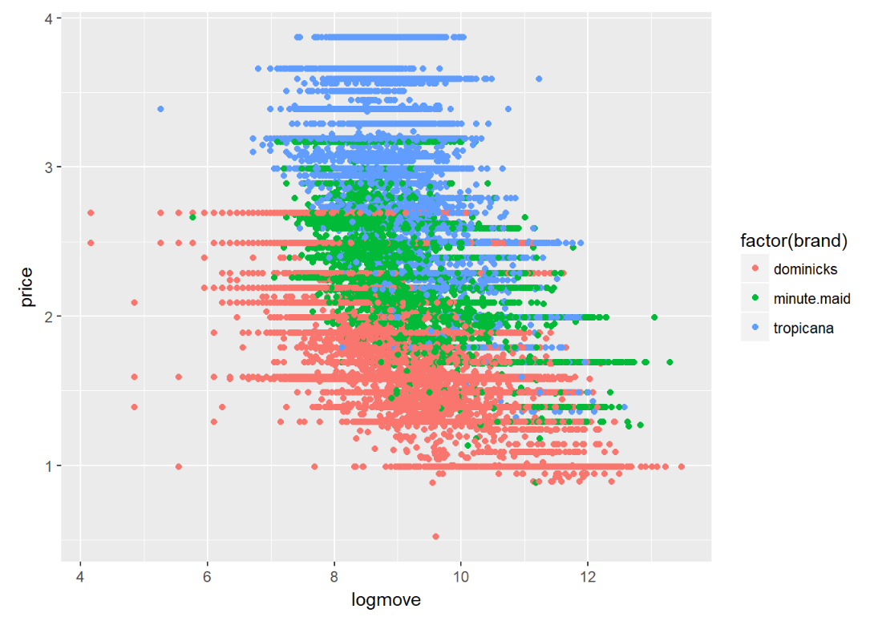

Slide 40
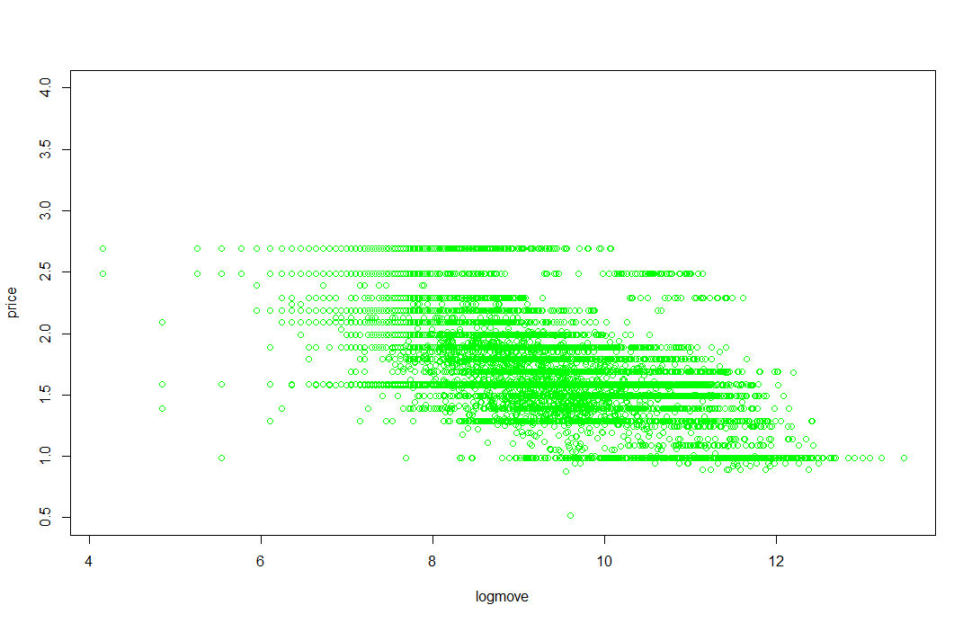
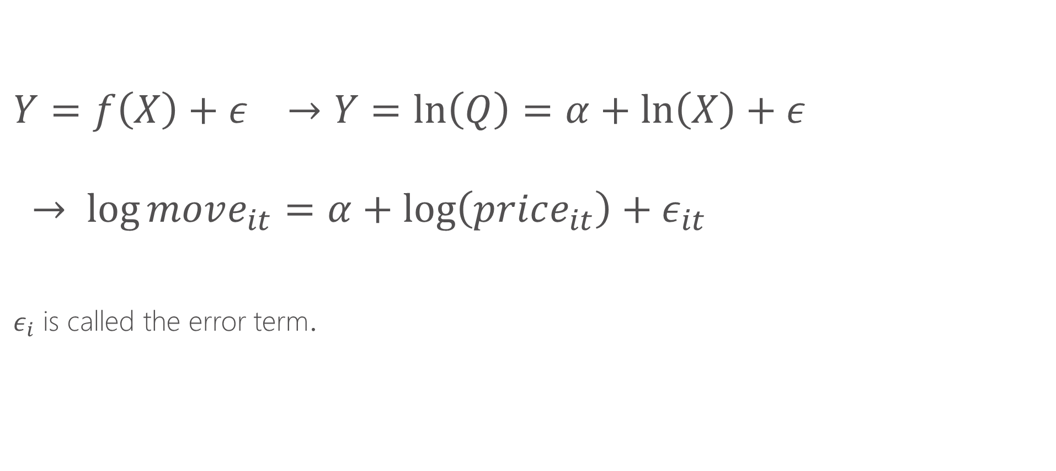
Estimating equations
$$Y=f\left(X\right)+ε →Y=\ln\left(Q\right)=α+\ln\left(X\right)+ε$$
$$→ \log{move_{it}=α+\log\left(price_{it}\right)+ε_{it}}$$
$ε_{i}$ is called the error term.

Slide 41

Parametric vs. non-parametric regression
$$Y=f\left(X\right)+ε$$
Parametric: $f$ defined by a model we write down with parameters that we have to estimate (e.g. $α, β_{1}, etc.)$
Non-parametric: we directly fit the data

Slide 42

Local averaging

Slide 43

Local averaging vs. bins

Slide 44

Kernels
A method of assigning higher weight to the points closer to the target point I am trying to fit.
Choice of kernel usually does not matter much.

Slide 45
Bandwidths
Bandwidths tell us how wide to make our kernel (window)
Larger bandwidths → smoother functions because there is more data used to make the averages
Bandwidth is sometimes called the smoothing parameter.
Bandwidths matter!

Slide 46
K-nearest neighbors
An alternative to bandwidths is instead of specifying a fixed window, we can say “use the nearest K nearest neighbors”
This ensures each bin has the same amount of data and can be a useful tool
Functionally it will often be quite similar to using a bandwidth, except when there are “sparse data” issues (then K-NNN is preferred)
Often expressed as a fraction of data. E.g. NN=.1 says “each bin is 10% of data”

Slide 47
Local polynomial regression
Thing of local averaging as fitting a constant for a given window of data
Instead of fitting a constant, we can fit a line (y=a*x + b) or a polynomial (y=a*x + b*x^2 + c), etc.
It is thus more general than local averaging, but very similar

Slide 48

Some examples

Slide 49

Some examples

Slide 50
Local polynomial in R locfit install.packages(locfit) library(locfit) Modeler needs to specify: bandwidth (or fraction of nearest neighbors), degree of the local polynomial Contrast: in parametric regression, we had to write down a model Aside: we’ll learn that non-parametric methods struggle in higher dimensions

Slide 51
When to use each model?
If there are a relatively small number of features (e.g. <4) then non-parametric makes a lot of sense.
With many features, the “curse of dimensionality” sets in and non-parametric methods fall apart (the “neighborhood” is generally empty)
Parametric models using interaction terms and polynomials are the preferred method with many features
“Semi-parametric” methods combine elements of both

Slide 52

Cross Validation & Model Selection
If we have two raw features, A and B, how many models can we make?
Without interactions (4): none, just A, just B, A + B
With interactions (8): A*B, A+B + A*B, A + A*B, B+ A*B
If we have p features then we have $2^{p+1}$ possible models!
$$p=29 −→1,073,741,824$$
We cannot possible run all these models… so we’ll learn methods to guide us (e.g., machine learning and cross validation)
Human intelligence is often a great guide as well.

Slide 53
Validation set methodology
Train the model with a subset of the data
Test the model on the remaining data (the validation set)
What data to choose for training vs. test?
In a time-series dimension, it is natural to hold out the last year (or time period) of the data, to simulate predicting the future based on all past data. In most settings, however, we’ll randomly select our training/test sets.

Slide 54

Cross-validation
A class of methods to do many training/test splits and average over all the runs
Here is a simple example of 5-fold cross validation. Gives 5 test sets → 5 estimates of MSE.
The 5-fold CV estimate is obtained by averaging these values.

Slide 55

K-fold cross-validation
Split the data up into K “folds”. Iteratively leave fold k out of the training data and use it to test.
The more folds, the smaller each testing set is (more training data), but the more times we need to run the estimation procedure. Using rules of thumb like 5—10 folds is often utilized in practice. This can be done with a simple for loop in R
For generalized linear models, the cv.glm() function can be used to perform k-fold cross validation. For example, this code loops over 10 possible polynomial orders and computes the 10-fold cross-validated error in each step

Slide 56
K-fold cross-validation
Split the data up into K “folds”. Iteratively leave fold k out of the training data and use it to test.
Lets do an example with the Orange Juice data:
Should we include socio-demographic characteristics or not if we care about predicting sales and order inventory.

Slide 57
ML != Econometrics
Machine Learning focuses on training models for predictive accuracy.
Good for: “How much will I sell next week?”
Seems very similar to economics/econometrics.
Econometrics focuses on parameters estimation. Strive for “causal” estimates of interpretable effects.
Good for: How much more will I sell if I drop price? How certain am I about that impact?

Slide 58
Consequence of different focus
ML models may not have individual feature “estimates”
Estimates may be systematically “too low” or “too high” (bias).
Don’t quantify uncertainty the same way. No classical standard errors or confidence intervals
But neither approach is always better → Learn when to do each

Slide 59
Example of ML concerns
Look at linear models: LASSO and Ridge Regression
Over-fitting
Cross-validation

Slide 60


Linear Models: LASSO and Ridge
Standard OLS Regression
$\min_{β}\sum_{i}{{\left(y_{i}−x_{i}β\right)}^{2}}$
LASSO
$\min_{β}\sum_{i}{{\left(y_{i}−x_{i}β\right)}^{2}}+λ\sum_{p}{\left|β_{p}\right|}$
Ridge Regression
$\min_{β}\sum_{i}{{\left(y_{i}−x_{i}β\right)}^{2}}+λ\sum_{p}{{\left|β_{p}\right|}^{2}}$
LASSO & Ridge both penalize coefficients towards 0
$λ$ controls penalization. Big $λ$ means push most coefficients towards 0.

Slide 61


Coefficient Budget and Penalization
𝜆 determines (inversely) “budget for coefficients”
“Small $λ$” = “Big budget” (close to OLS)
Penalty form affects shape (trade-off between params)
LASSO
Ridge

Slide 62

Penalization and Bias
Ridge will smoothly make coefficients small
LASSO will push many coefficients to 0 (“model selection”)
LASSO
Ridge

Slide 63

Overfitting
ML models are very flexible. Try to fit all patterns
Great when learning the main relationships
Can go too far and fit minor quirks in the data
Always some “noise” in a particular sample.
World changes so many small things in the past won’t generalize to the future.
Overfitting makes model perform worse on new data (out-of-sample).
We want just the “right” amount of flexibility.
For linear models this is controlled by $λ$.

Slide 64

Estimating Prediction Error
Quantify overfitting. Estimate prediction error $\hat{Error}(λ)$
k-fold Cross-Validation:
Split data randomly into k portion (e.g., 5 or 10)
For each s in {1,…,k}:
Train model on all but section s (most of the data)
Use trained model to calculate error on section s. Call that $Error(λ,s)$
Then $\hat{Error}\left(λ\right)=\frac{1}{k}\sum_{s}{Error(λ,s)}$

Slide 65

Overfitting Solution
Pick $λ$ to minimize out of sample error as given by $Error\left(λ\right)$!

Slide 66
Choosing ML Models
Lots of different methods
LASSO, Artificial Neural Nets, Support Vector Machines, Trees
Which do a good job (predictively) in my domain?
Do I need interpretable features?
More interpretable: LASSO, Ridge regression
Less interpretable (“black box”): Neural Nets
The Pricing Engine has parts where both can be used.

Slide 67
Loss versus Prediction
 |  | Sample
 |  | In (Inference & Research Design) | Out (prediction)
Penalty | L1 Norm | Down weights Outliers | LASSO Cross Validation
 | L2 Norm | OLS Estimation | Ridge Cross Validation

